Slide 1
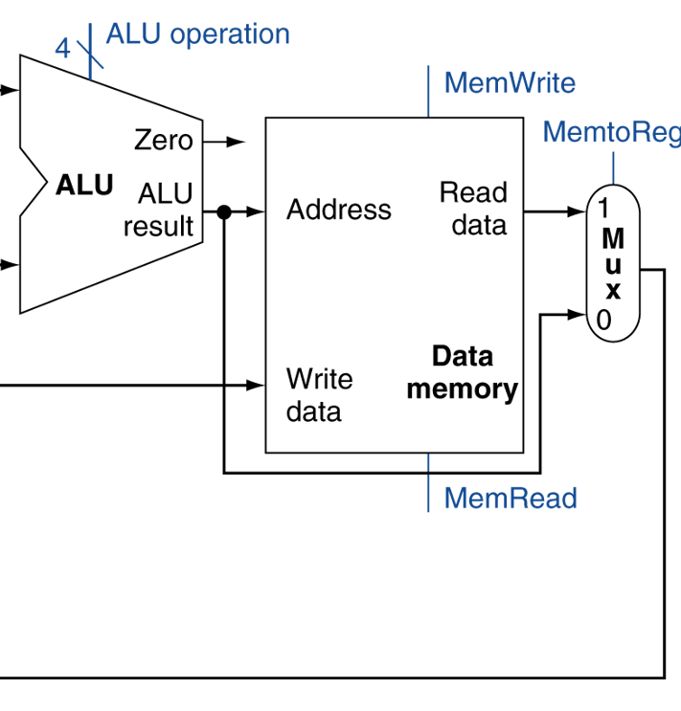
Quiz 3 (Chapter 4.1 to 4.4 & Combinational Logic and FSM)
Draw the combinational and state elements that are needed to execute a R-format instruction. Draw the datapath between them.
In the figure on the right, briefly describe what the MemtoReg MUX will do to execute a lw (load word) instruction.
Write down the combinational logic formula and its truth table for this statement: the door opens when you kick or push it and it is unlocked.

